Slide 1
Lecture.No:12 Sequence
SEQUENCE:
A sequence is just a list of elements usually written in a row.
EXAMPLES:
1. 1, 2, 3, 4, 5, …
2. 4, 8, 12, 16, 20,…
3. 2, 4, 8, 16, 32, … 4. 1, 1/2, 1/3, 1/4, 1/5, …
5. 1, 4, 9, 16, 25, …
6. 1, -1, 1, -1, 1, -1, …
FORMAL DEFINITION:
A sequence is a function whose domain is the set of integers greater than or equal to a
particular integer n0. Usually this set is the set of Natural numbers {1, 2, 3, …} or the set of whole numbers {0, 1, 2, 3, …}.
NOTATION:
We use the notation an to denote the image of the integer n, and call it a term of the
sequence. Thus A1 a2, a3, a4 …, an, …
represent the terms of a sequence defined on the set of natural numbers N.
Note that a sequence is described by listing the terms of the sequence in order of
increasing subscripts.

Slide 2
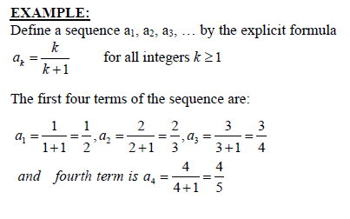
FINDING TERMS OF A SEQUENCE GIVEN BY AN EXPLICIT FORMULA:

Slide 3
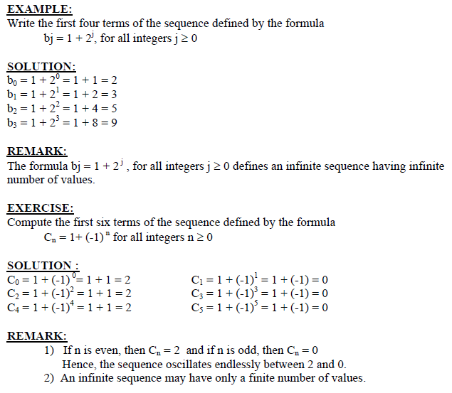

Slide 4
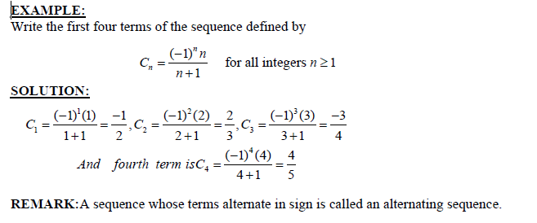

Slide 5
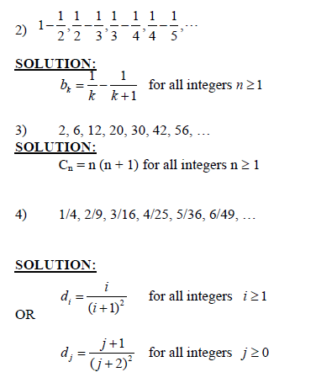
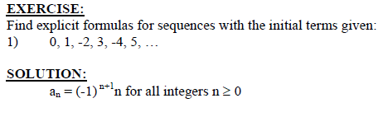

Slide 6
ARITHMETIC SEQUENCE:
A sequence in which every term after the first is obtained from the preceding term by
adding a constant number is called an arithmetic sequence or arithmetic progression (A.P.) The constant number, being the difference of any two consecutive terms is called the
common difference of A.P., commonly denoted by “d”.
EXAMPLES:
1. 5, 9, 13, 17, … (common difference = 4)
2. 0, -5, -10, -15, … (common difference = -5)
3. x + a, x + 3a, x + 5a, … (common difference = 2a)
GENERAL TERM OF AN ARITHMETIC SEQUENCE:
Let a be the first term and d be the common difference of an arithmetic sequence. Then
the sequence is a, a+d, a+2d, a+3d, …
If ai, for i ≥ 1, represents the terms of the sequence then
a1 = first term = a = a + (1-1) d
a2 = second term = a + d = a + (2-1) d
a3 = third term = a + 2d = a + (3 -1) d
By symmetry
an = nth term = a + (n - 1)d for all integers n ≥1.

Slide 7
EXAMPLE:
Find the 20th term of the arithmetic sequence
3, 9, 15, 21, …
SOLUTION:
Here a = first term = 3
d = common difference = 9 - 3 = 6
n = term number = 20
a20 = value of 20th term = ?
Since an = a + (n - 1) d; n ≥1
∴ a20 = 3 + (20 - 1) 6
= 3 + 114
= 117

Slide 8
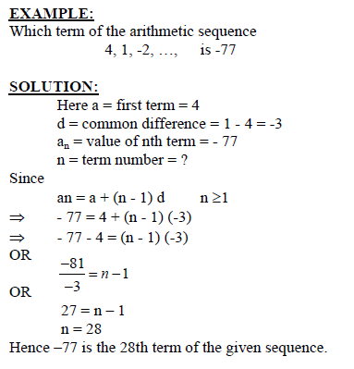

Slide 9
EXERCISE:
Find the 36th term of the arithmetic sequence whose 3rd term is 7 and 8th term is 17.
SOLUTION:
Let a be the first term and d be the common difference of the arithmetic sequence.
Then
an = a + (n - 1)d n ≥ 1
⇒ a3 = a + (3 - 1) d
and a8 = a + (8 - 1) d
Given that a3 = 7 and a8 = 17. Therefore
7 = a + 2d……………………(1)
and 17 = a + 7d………….………..(2)
Subtracting (1) from (2), we get,
10 = 5d
⇒ d = 2
Substituting d = 2 in (1) we have
7 = a + 2(2)
which gives a = 3
Thus, an = a + (n - 1) d
an = 3 + (n - 1) 2 (using values of a and d)
Hence the value of 36th term is
a36 = 3 + (36 - 1) 2
= 3 + 70
= 73

Slide 10
GEOMETRIC SEQUENCE:
A sequence in which every term after the first is obtained from the preceding term by
multiplying it with a constant number is called a geometric sequence or geometric progression (G.P.) The constant number, being the ratio of any two consecutive terms is called the commonratio of the G.P. commonly denoted by “r”.
EXAMPLE:
1. 1, 2, 4, 8, 16, … (common ratio = 2)
2. 3, - 3/2, 3/4, - 3/8, … (common ratio = - 1/2)
3. 0.1, 0.01, 0.001, 0.0001, … (common ratio = 0.1 = 1/10)
GENERAL TERM OF A GEOMETRIC SEQUENCE:
Let a be the first tem and r be the common ratio of a geometric sequence. Then the
sequence is a, ar, ar2, ar3, …
If ai, for i ≥ 1 represent the terms of the sequence, then
a1 = first term = a = ar1-1
a2 = second term = ar = ar2-1
a3 = third term = ar2 = ar3-1
………………
an = nth term = arn-1; for all integers n ≥ 1

Slide 11
EXAMPLE:
Find the 8th term of the following geometric sequence
4, 12, 36, 108, …
SOLUTION:
Here a = first term = 4
r = common ratio = = 3
n = term number = 8
a8 = value of 8th term = ?
Since an = arn-1; n ≥ 1
⇒ a8 = (4)(3)8-1
= 4 (2187)
= 8748

Slide 12
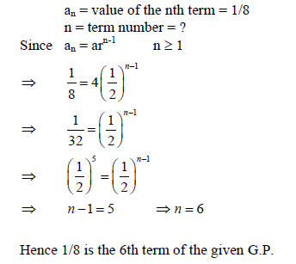
EXAMPLE:
Which term of the geometric sequence is 1/8 if the first term is 4 and common ratio ½
SOLUTION:
Given a = first term = 4
r = common ratio = 1/2

Slide 13
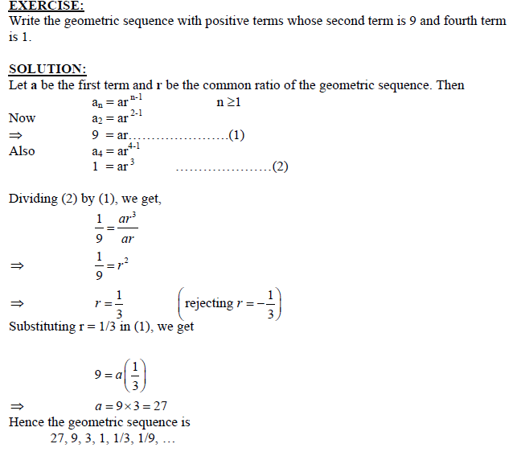

Slide 14
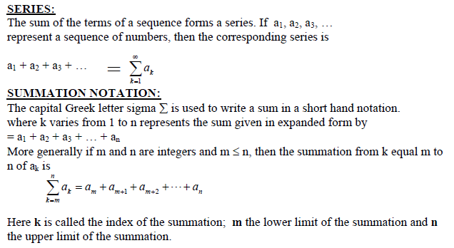
Series

Slide 15
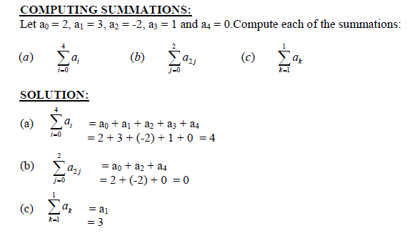

Slide 16
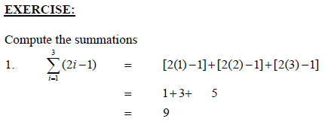
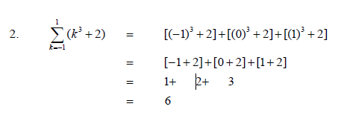

Slide 17
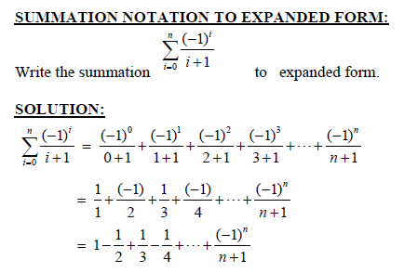

Slide 18
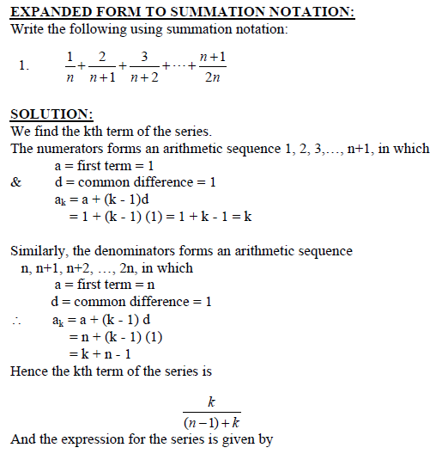
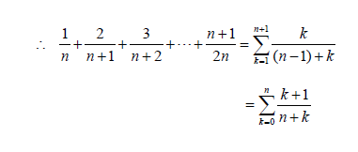

Slide 19
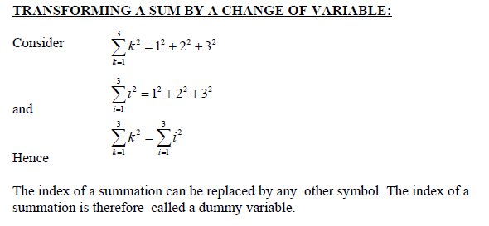

Slide 20
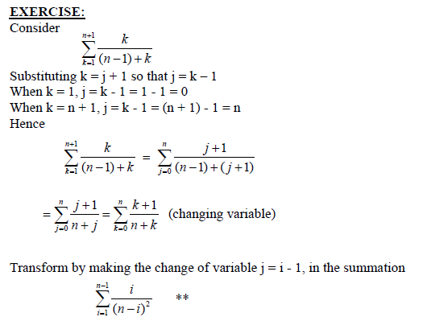

Slide 21
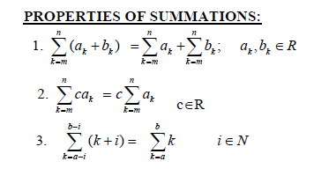
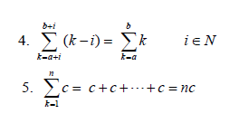

Slide 22
